Slide 1
Knowledge Graph

Slide 2
1. GAKE : Graph Aware Knowledge Embedding

Slide 3
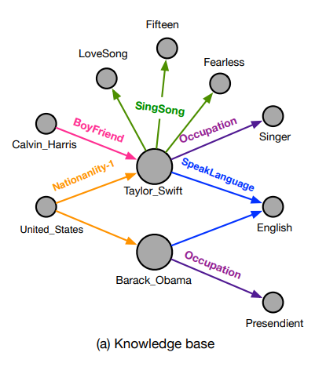
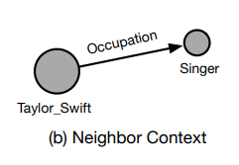
1. Basic concept
- Knowledge base consists of three types of graph context
Neighbor Context
Edge Context
Path Context
Consists of the target entity(Taylor Swift) and its directed linked entities(Singer) along with their relations(Occupation).

Slide 4
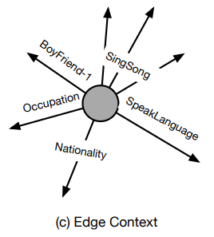
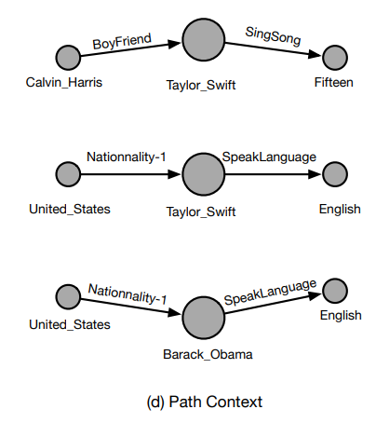
1. Basic concept
Means all kinds of relations relevant to the target entity.
Notice that different relations has different representation power
-> utilizing attention mechanism
Paths in the given graph containing the target entity.
Nationality -1 means a reverse of Nationality.

Slide 5

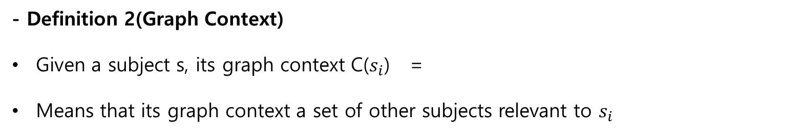
2. Approach
- Definition 1(Knowledge Graph)
A Knowledge graph G = (V, E) where V is the set of vertices and E is the set of edges.
For each fact (h, t, r), we create two corresponding vertices vi and vj in the graph G, where i and j are unique index of h and t respectively.
After that, we create a directed edge e, which represents the relation r, from vi to vj
Moreover, s = (t, k) where t indicates subject type and k is the index of the corresponding vertex or edge.
- Definition 2(Graph Context)
Given a subject s, its graph context C($s_{i}$) =
Means that its graph context a set of other subjects relevant to $s_{i}$

Slide 6
2. Approach
- Problem(Knowledge Graph Embedding)
Given a knowledge graph G = (V, E),
we want to represent each v ∈ V and r ∈ E by a vector with real numbers!!!!

Slide 7
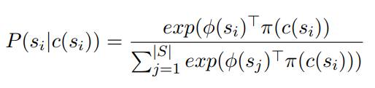
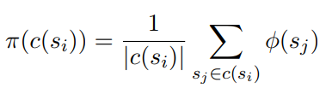

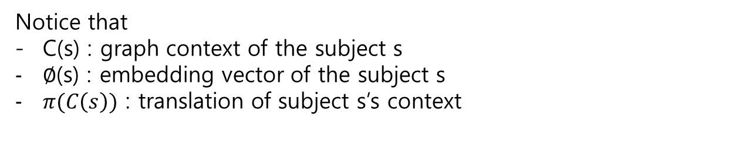
3. Framework
Generally, the learning objective of GAKE is to predict missing subjects given by their context.
where ,
Notice that
C(s) : graph context of the subject s
$∅$(s) : embedding vector of the subject s
$π(C\left(s\right))$ : translation of subject s’s context

Slide 8
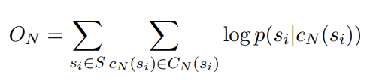
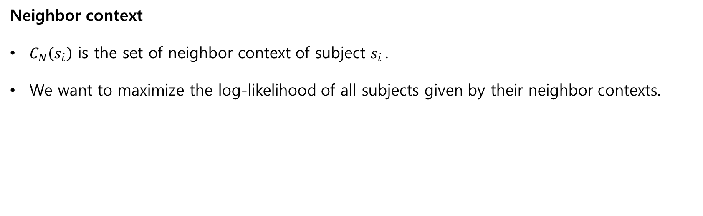
3. Framework
Neighbor context
$C_{N}\left(s_{i}\right)$ is the set of neighbor context of subject $s_{i }$.
We want to maximize the log-likelihood of all subjects given by their neighbor contexts.

Slide 9
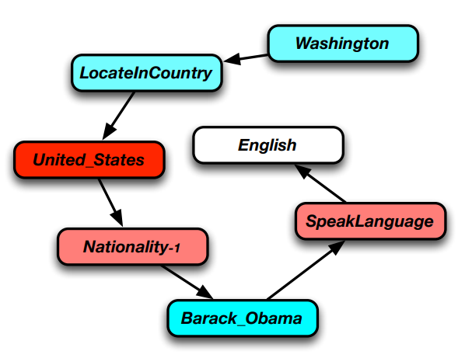
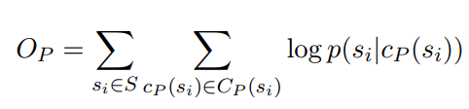
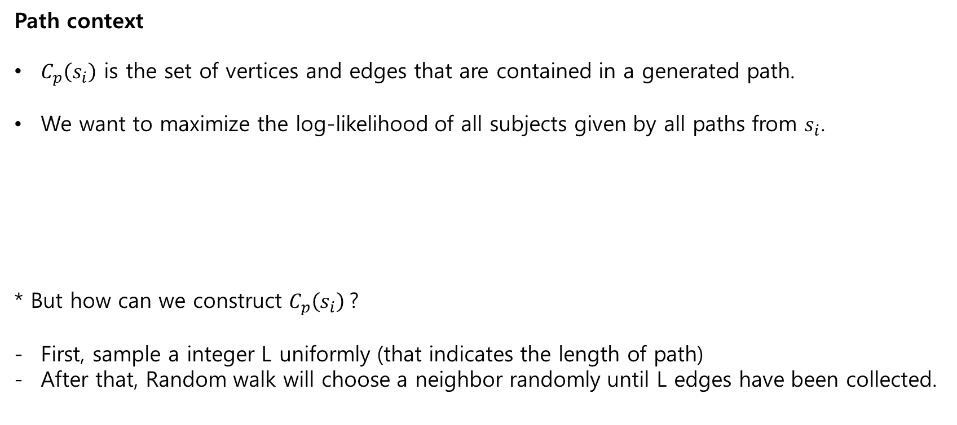
3. Framework
Path context
$C_{p}\left(s_{i}\right)$ is the set of vertices and edges that are contained in a generated path.
We want to maximize the log-likelihood of all subjects given by all paths from $s_{i}$.
* But how can we construct $C_{p}\left(s_{i}\right)$?
First, sample a integer L uniformly (that indicates the length of path)
After that, Random walk will choose a neighbor randomly until L edges have been collected.

Slide 10
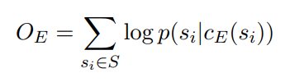

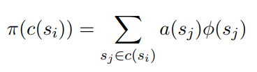
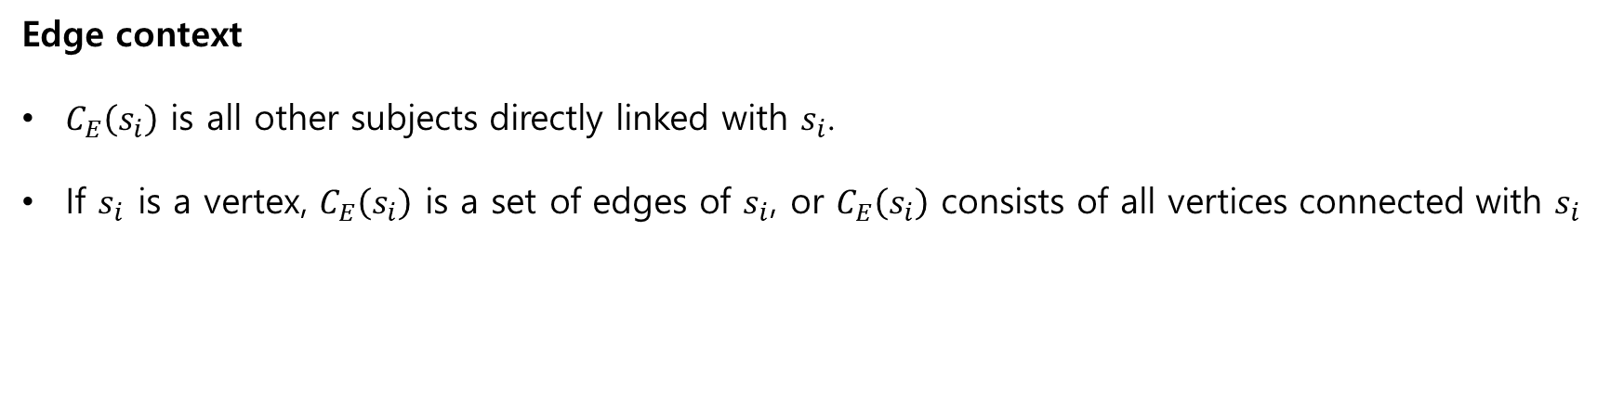
3. Framework
Edge context
$C_{E}\left(s_{i}\right)$ is all other subjects directly linked with $s_{i}$.
If $s_{i}$ is a vertex, $C_{E}\left(s_{i}\right)$ is a set of edges of $s_{i}$, or $C_{E}\left(s_{i}\right)$ consists of all vertices connected with $s_{i}$
+ attention mechanism
In reality, different subjects may have different power of influence to represent the target subject.
ex) Taylor Swift -> nationality < SingSong

Slide 11

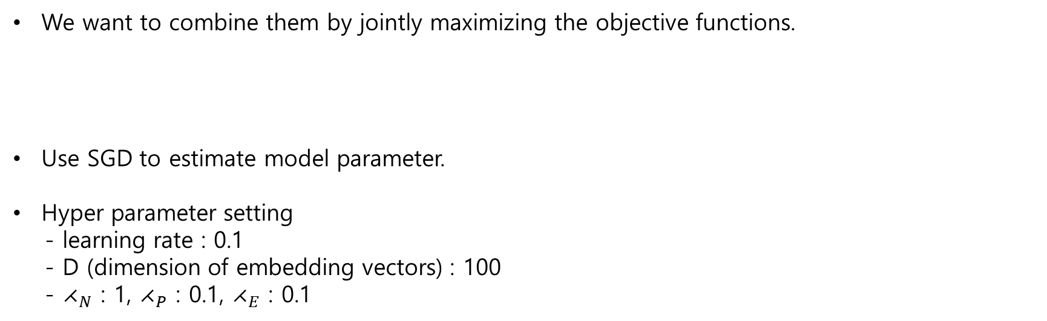
3. Training
We want to combine them by jointly maximizing the objective functions.
Use SGD to estimate model parameter.
Hyper parameter setting
- learning rate : 0.1
- D (dimension of embedding vectors) : 100
- $⋌_{N}$ : 1, $⋌_{P}$ : 0.1, $⋌_{E}$ : 0.1

Slide 12
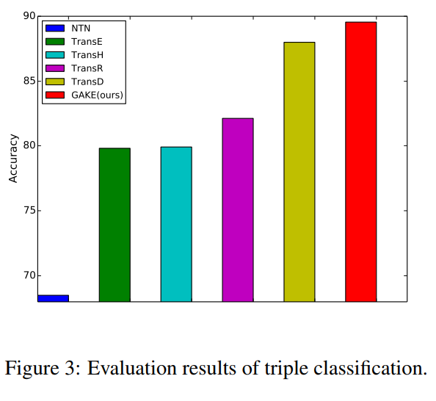
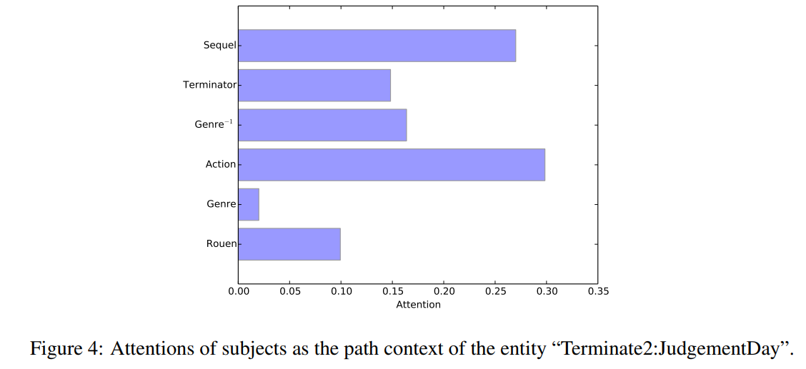
4. Experiments and Results
Triple classification
For a query (h, r, t), we define a relation-specific threshold ρr
by maximizing the classification accuracy on validation set.
After that, we calculate the conditional probability P(t|h, r)
by regarding h and r as the context of t.
we say (h, r, t) is positive (correct)
if P(t|h, r) ≥ ρr, where ρr is estimated
according to the validation data.

Slide 13
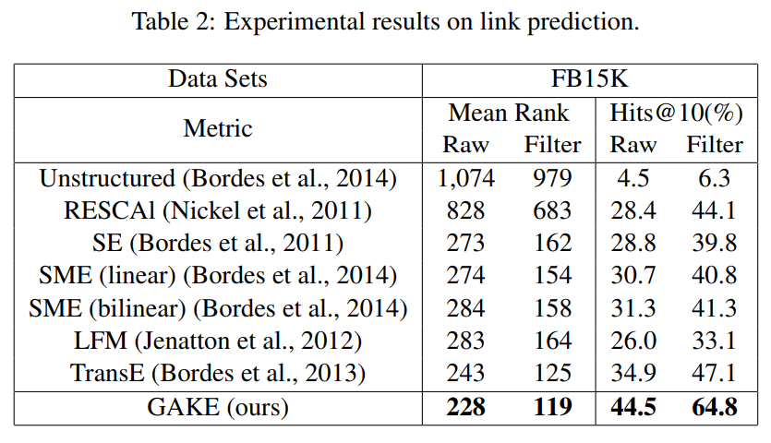
4. Experiments and Results
2. Link Prediction
To predict the missing h or t given (h, r) or (r, t) respectively.
Conduct the evaluation by ranking the set of candidate entities in knowledge graph.

Slide 14
2. Structured Embedding via Pairwise Relations and Long-Range Interactions in Knowledge Base

Slide 15
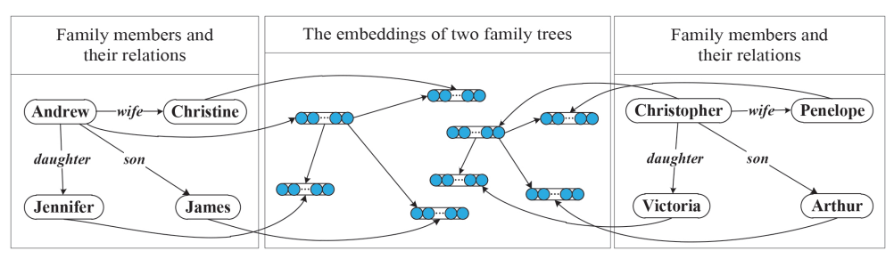
1. Basic concept
Two individual family trees are embedded into a common continuous vector spaces.
Persons are represented as different vectors and family relations are represented as matrixes.

Slide 16





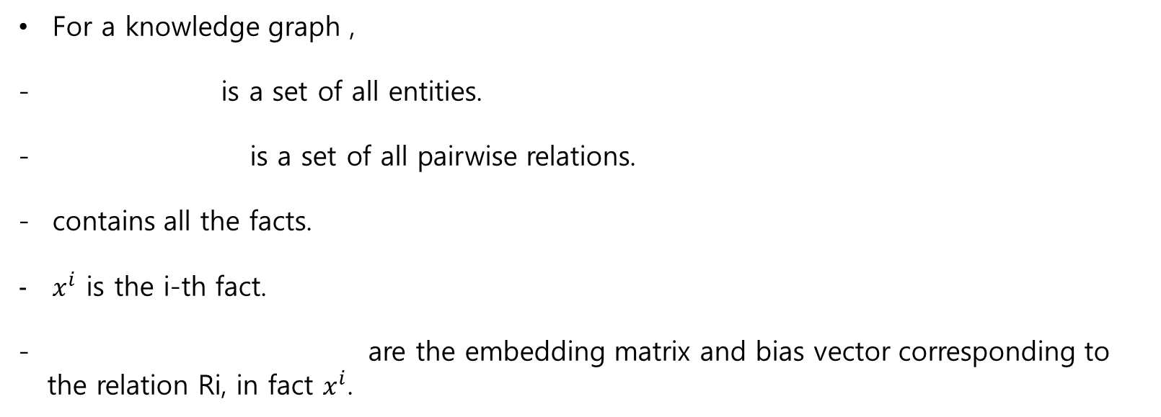
2. Framework
For a knowledge graph ,
- is a set of all entities.
- is a set of all pairwise relations.
contains all the facts.
$x^{i}$ is the i-th fact.
are the embedding matrix and bias vector corresponding to
the relation Ri, in fact $x^{i}$.

Slide 17


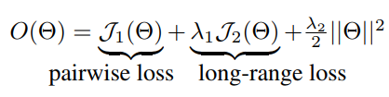
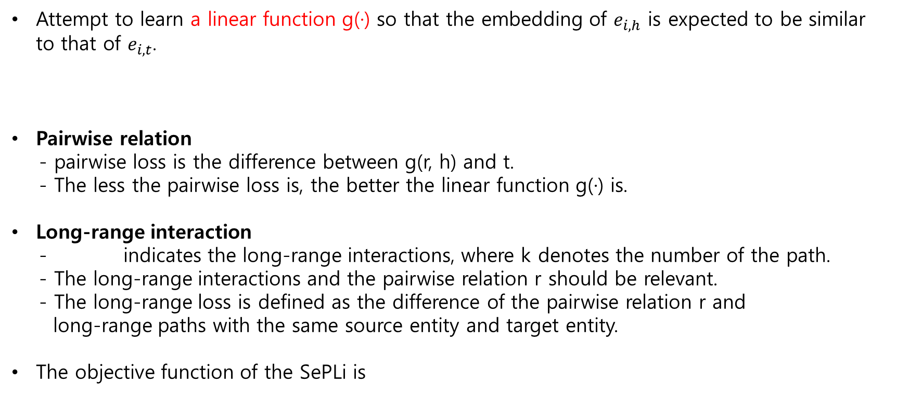
2. Framework
Attempt to learn a linear function g(·) so that the embedding of $e_{i,h}$ is expected to be similar to that of $e_{i,t}$.
Pairwise relation
- pairwise loss is the difference between g(r, h) and t.
- The less the pairwise loss is, the better the linear function g(·) is.
Long-range interaction
- indicates the long-range interactions, where k denotes the number of the path.
- The long-range interactions and the pairwise relation r should be relevant.
- The long-range loss is defined as the difference of the pairwise relation r and
long-range paths with the same source entity and target entity.
The objective function of the SePLi is

Slide 18

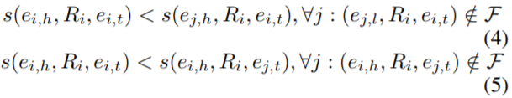

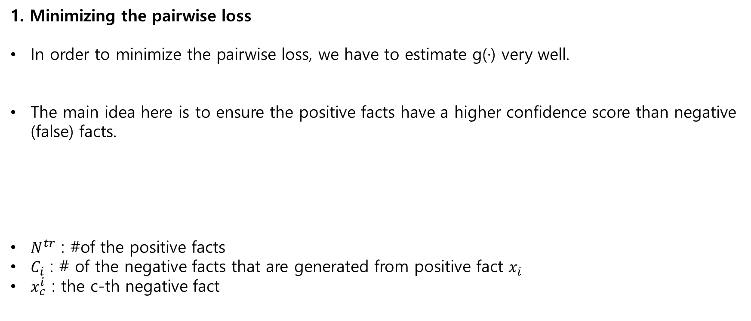
2. Framework
1. Minimizing the pairwise loss
In order to minimize the pairwise loss, we have to estimate g(·) very well.
The main idea here is to ensure the positive facts have a higher confidence score than negative (false) facts.
$N^{tr}$ : #of the positive facts
$C_{i}$ : # of the negative facts that are generated from positive fact $x_{i}$
$x_{c}^{i}$ : the c-th negative fact

Slide 19

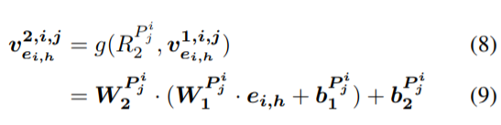


2. Framework
2. Minimizing the long-range loss
For each pairwise relation $R_{i}$, assume that we find the top K paths $P_{j}^{i}$ with weights $p_{j}^{i}$.
As a result, we expect that the difference of g(Ri , ei,h) and f(Ri , ei,h) is the minimum.

Slide 20
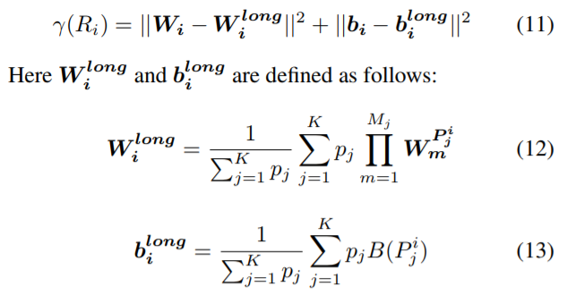
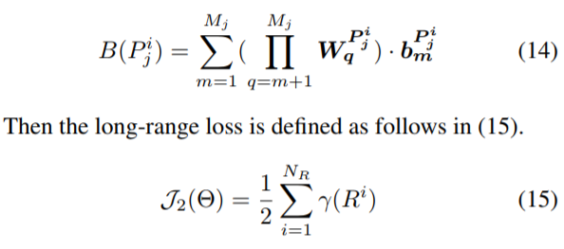
2. Framework
2. Minimizing the long-range loss
Propose to minimize the following objective function:

Slide 21
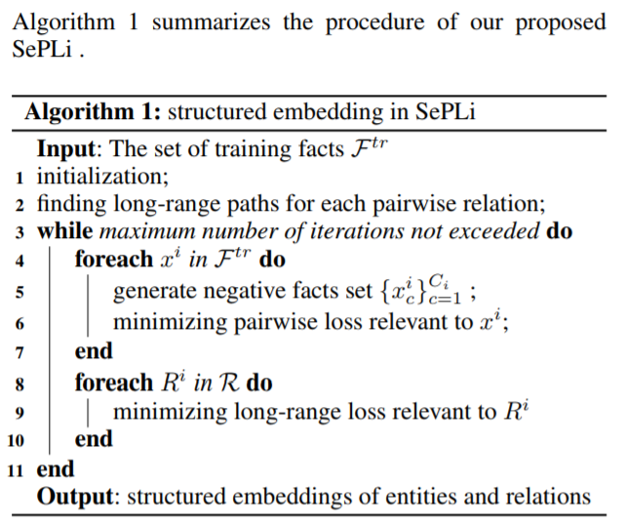
2. Framework

Slide 22
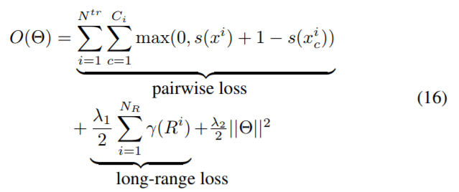

3. Training
We want to minimize the objective functions.
Hyper parameter setting
- entity vectors, relation matrixes, and biases are all initialized by
a uniform distribution on [−0.001, 0.001]
- D (dimension of embedding vectors) : 100
- $⋌_{1}$ : 0.01, $⋌_{2}$ : 0.0001

Slide 23
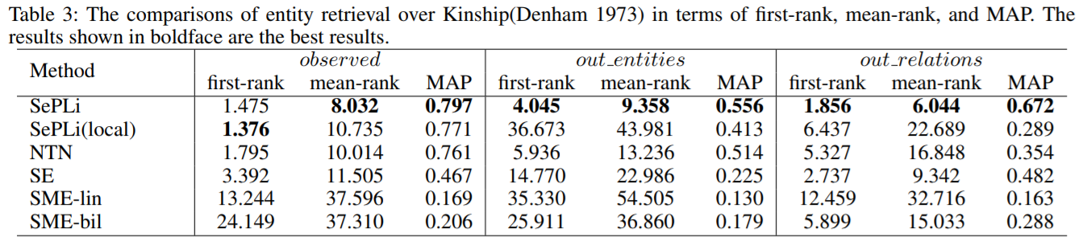
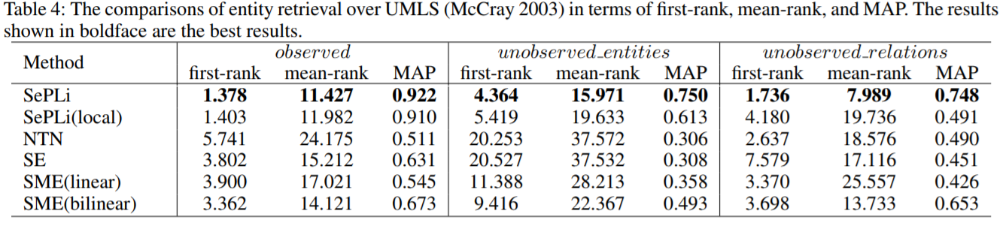
3. Results

Slide 24
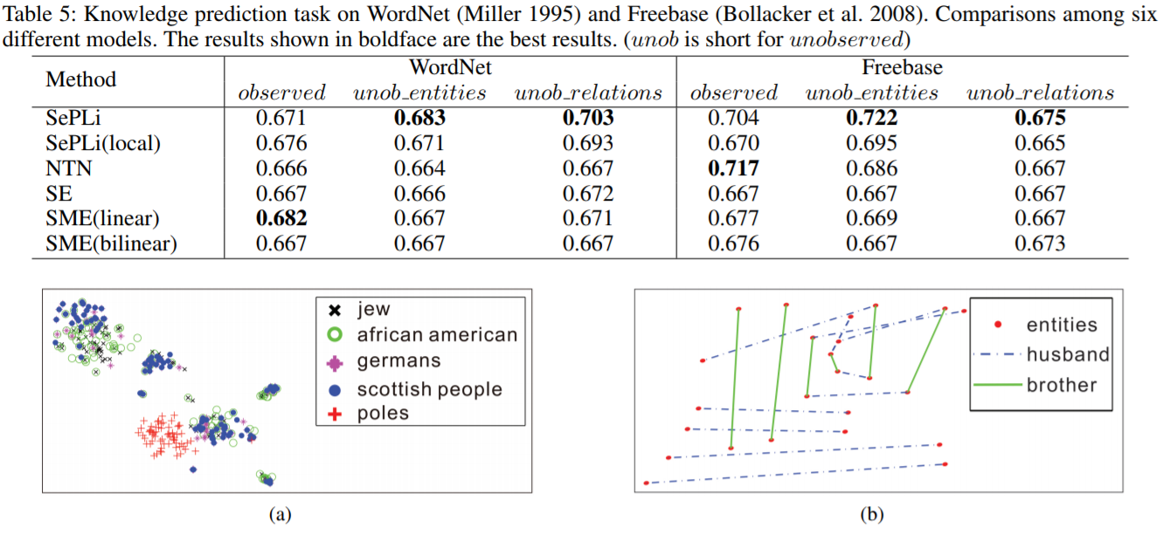
3. Results

Slide 25
3. ProjE : Embedding Projection for Knowledge Graph Completion

Slide 26
1. Distinction
Instead of measuring the distance between input triple <h, r, ?> and entity candidates on a unified or a relationship specific plane,
Project the entity candidates onto a target vector representing the input data.
Combine the embedding vectors representing the input data into a target vector using a learnable combination operator
Rather than optimizing the margin-based pairwise ranking loss,
optimize a ranking loss of the list of candidate entities(or relationships) collectively.

Slide 27
2. Methodology
Learn a combination operator that creates a target vector from the input data.
→ the candidate entities are each projected onto the same target vector thereby revealing the candidate’s similarity score as a scalar.
Given two input embeddings, view the prediction task as ranking problem where the top-ranked candidates are the correct entities.
To generate this ordered list, we project each of the candidates onto a target vector defined by two input embeddings through a combination operator.

Slide 28

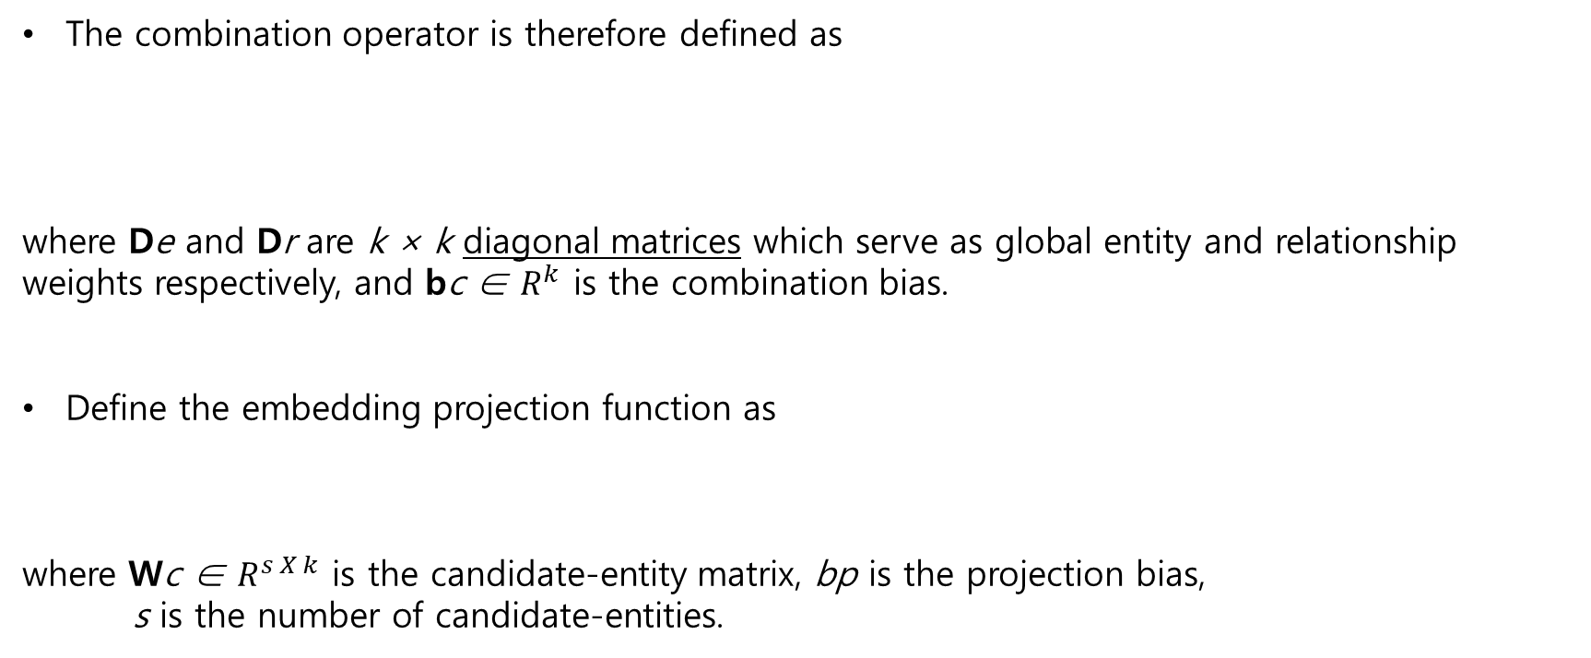
2. Methodology
The combination operator is therefore defined as
where De and Dr are k × k diagonal matrices which serve as global entity and relationship weights respectively, and bc ∈ $R^{k}$ is the combination bias.
Define the embedding projection function as
where Wc ∈ $R^{s X k}$ is the candidate-entity matrix, bp is the projection bias,
s is the number of candidate-entities.
Why??

Slide 29
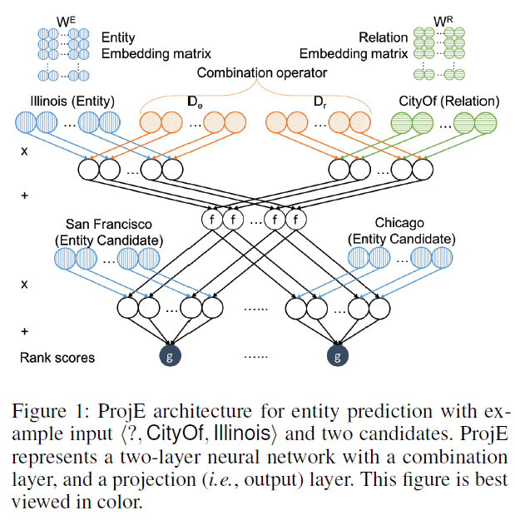
2. Methodology
Given a tail entity Illinois and a relationship CityOf,
our task is to calculate the scores of each
head entity.
For simplicity, only illustrate two candidates in Fig. 1

Slide 30
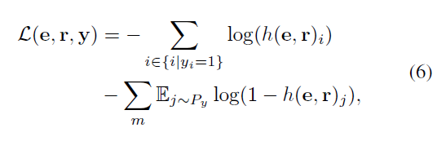

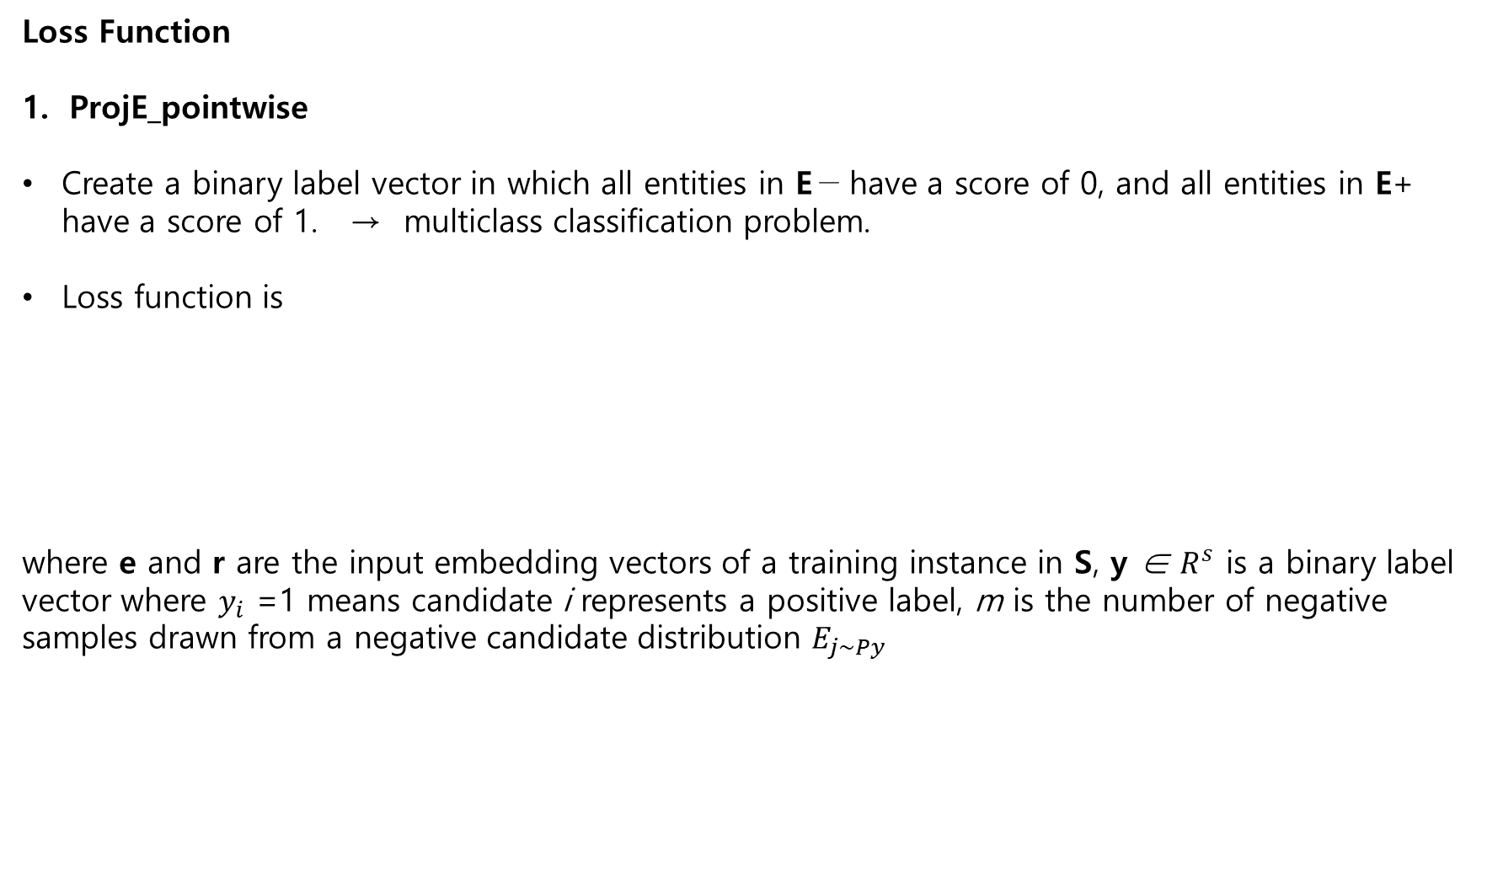
2. Methodology
Loss Function
ProjE_pointwise
Create a binary label vector in which all entities in E− have a score of 0, and all entities in E+ have a score of 1. → multiclass classification problem.
Loss function is
where e and r are the input embedding vectors of a training instance in S, y ∈ $R^{s}$ is a binary label vector where $y_{i}$ =1 means candidate i represents a positive label, m is the number of negative samples drawn from a negative candidate distribution $E_{j\sim Py}$

Slide 31
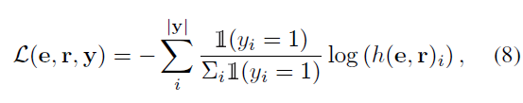
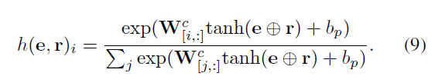
2. Methodology
Loss Function
2. ProjE_listwise
Loss function is
where the target probability (i.e., the target score) of a positive candidate is 1 / (total number of positive candidates of the input instance).

Slide 32
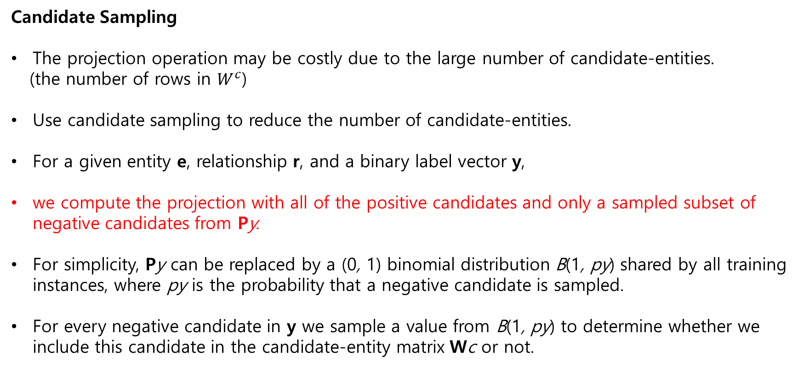
2. Methodology
Candidate Sampling
The projection operation may be costly due to the large number of candidate-entities.
(the number of rows in $W^{c}$)
Use candidate sampling to reduce the number of candidate-entities.
For a given entity e, relationship r, and a binary label vector y,
we compute the projection with all of the positive candidates and only a sampled subset of negative candidates from Py.
For simplicity, Py can be replaced by a (0, 1) binomial distribution B(1, py) shared by all training instances, where py is the probability that a negative candidate is sampled.
For every negative candidate in y we sample a value from B(1, py) to determine whether we include this candidate in the candidate-entity matrix Wc or not.

Slide 33
3. Experiments and Results
Hyper parameter setting
lr(learning rate)= 0.01, b(mini-batch size) = 200, α(regularizer weight = 1e−5,
Pd(dropout probability) = 0.5
k = 200, py = 0.5 for the entity prediction task
k = 100, py = 0.75 for the relationship prediction task.

Slide 34
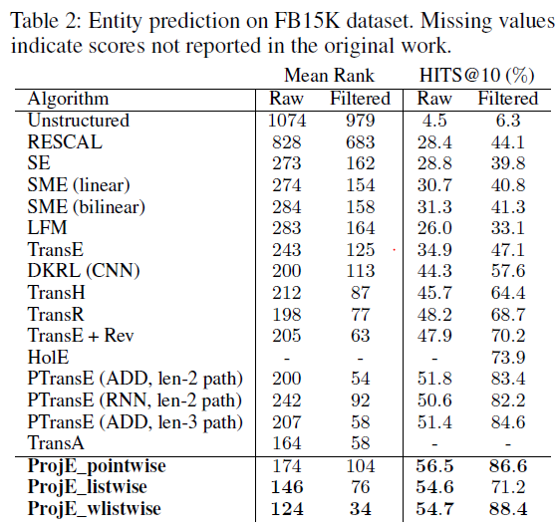
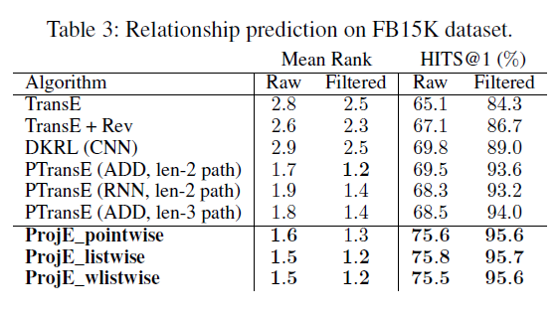
3. Experiments and Results

